Slide 1
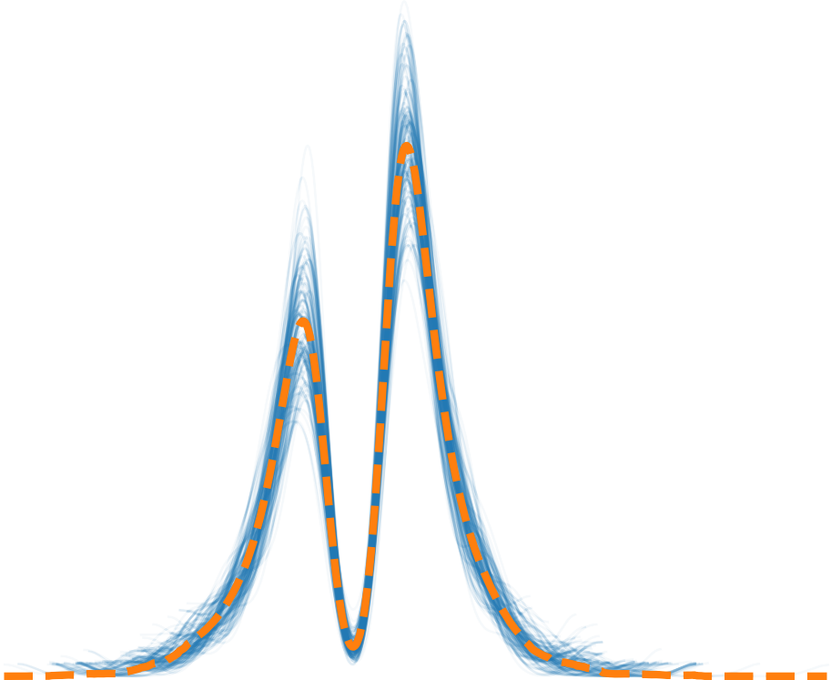
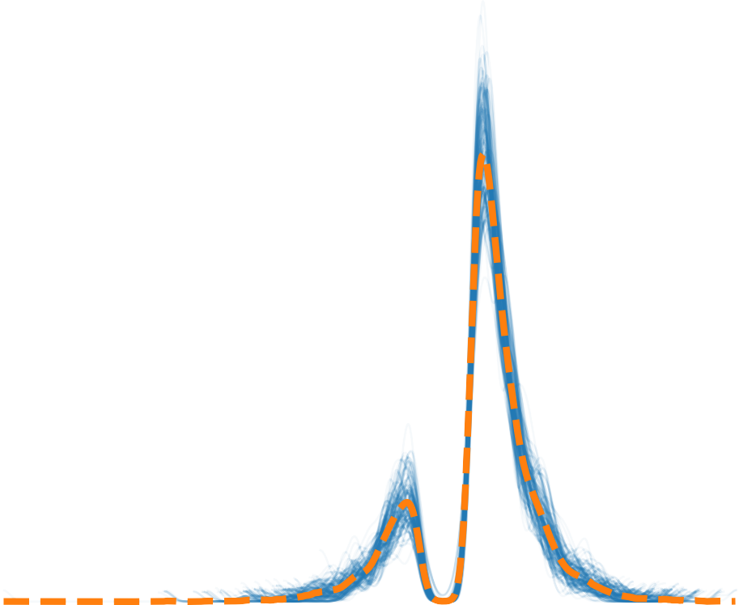
5
0
5
10
15
10
5
0
5
10
rt / rt

Slide 2
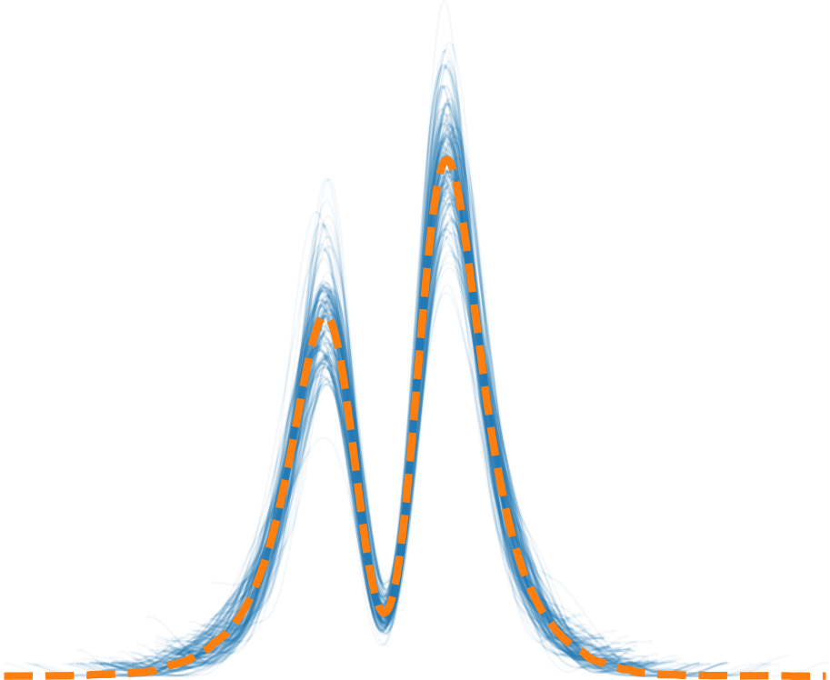
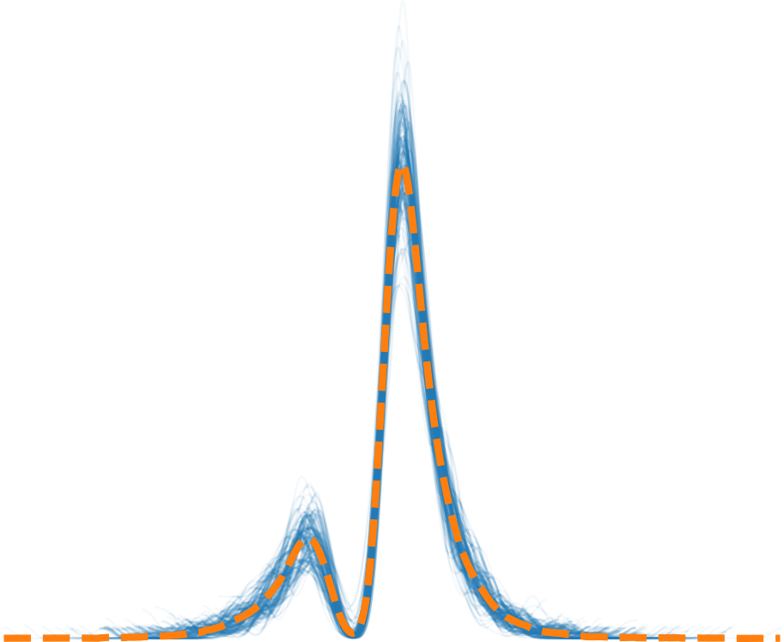
5
0
5
10
10
5
0
5
10
rt / rt

Slide 3
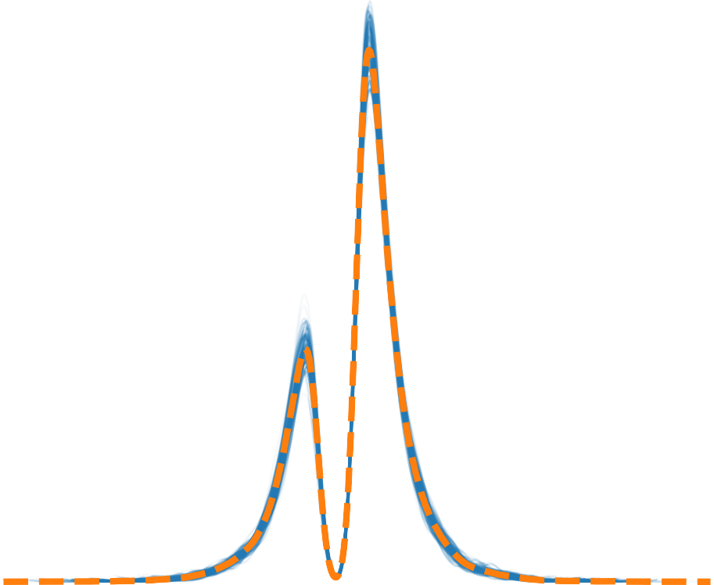
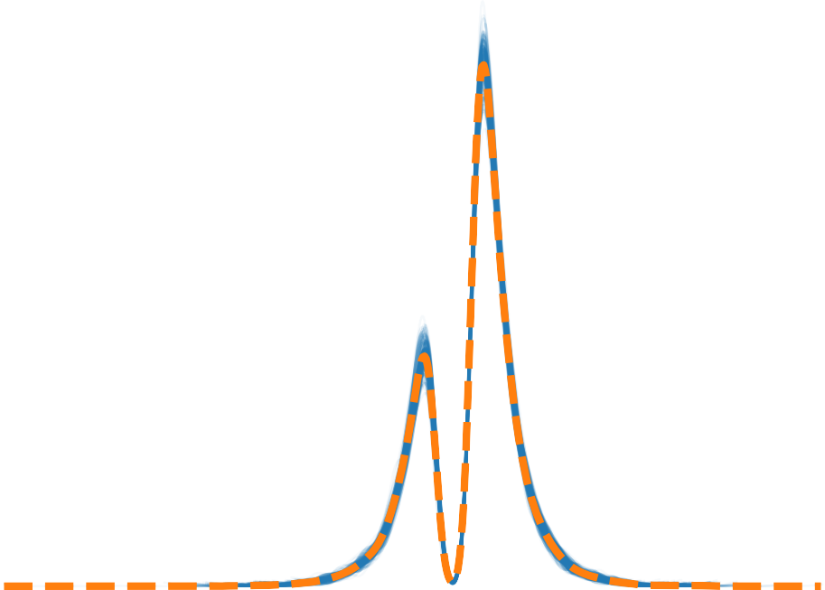
10
5
0
5
10
15
10
5
0
5
10
rt / rt

Slide 4
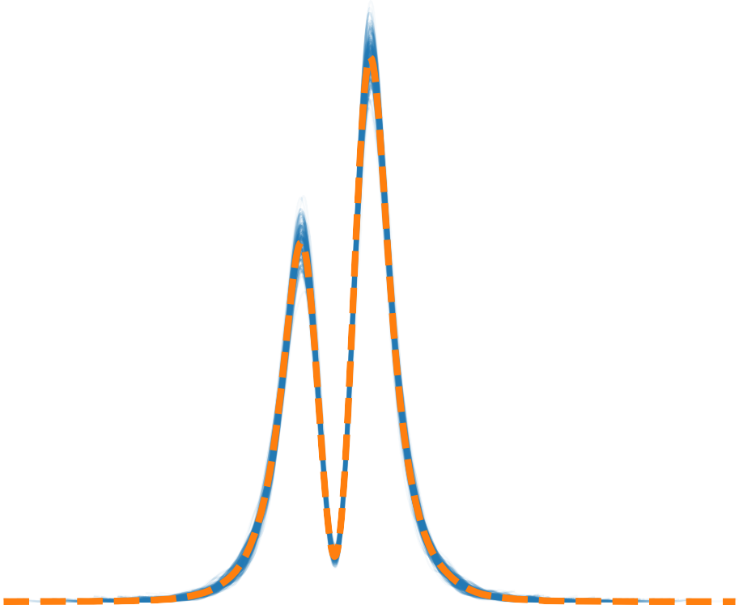
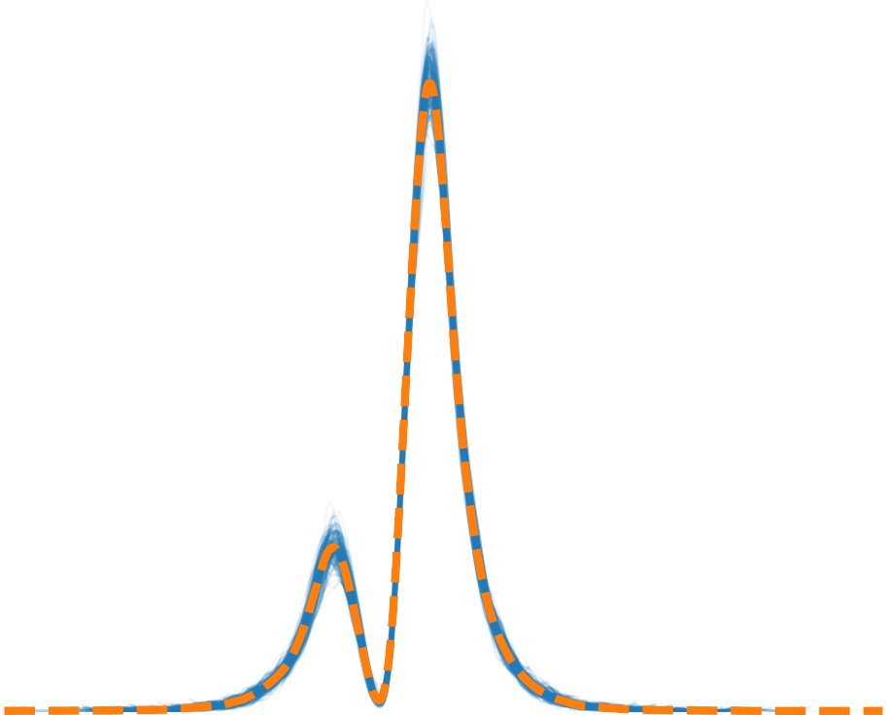
10
0
rt / rt
5
10
5
0
rt / rt
5
10

Slide 5
Posterior predictive
Observed
Posterior predictive mean

